Slide 1

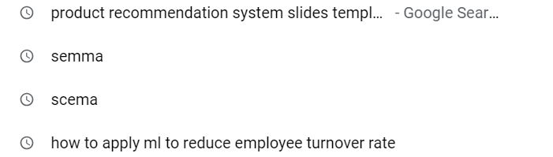
PRODUCT RECOMMENDATION SYSTEM
Intro
Architecture
Technology & Tools used
Project Infrastructure
P.R Algorithm
Discussion & Results
Conclusion
GROUP 3 MEMBERS OF WQD7007
WEE HIN SHEIK (S2190151)
SAMUEL TAN JOO WOON (S2196123)
TAN KAI YING (22051081)
LEE TSE LYN MAVIS (22050480)

Slide 2
Product Recommendation System in E-Commerce Industry
Intro
Architecture
Technology & Tools used
Project Infrastructure
P.R Algorithm
Results
Conclusion
Revolutionized the e-commerce industry
Businesses are using AI to recommend products to customers based on their browsing history and purchase patterns
Enhance user experience and has significant impact on sales
Reinforces their trust in the brand's ability to cater to their individual needs
For Example:
product recommendations account for up to 31% of total e-commerce site revenue
Used by different sectors around the world such as ASOS, ZARA, AMAZON and etc.

Slide 3
PROBLEM STATEMENT
Intro
Architecture
Technology & Tools used
Project Infrastructure
P.R Algorithm
Results
Conclusion
Not all the products are in line with the current trend as customers would spend hours scrolling and looking for the correct products.
Customers would be frustrated, and customer satisfaction would be negatively impacted.
Important to leverage on the potential of big data to develop a product recommendation system.

Slide 4
PROJECT OBJECTIVES
Intro
Architecture
Technology & Tools used
Project Infrastructure
P.R Algorithm
Results
Conclusion
To design and develop a product recommendation system that is based on current trends.
To publish the recommended products in online platform.
To streamline product discovery and increase customer satisfaction

Slide 5
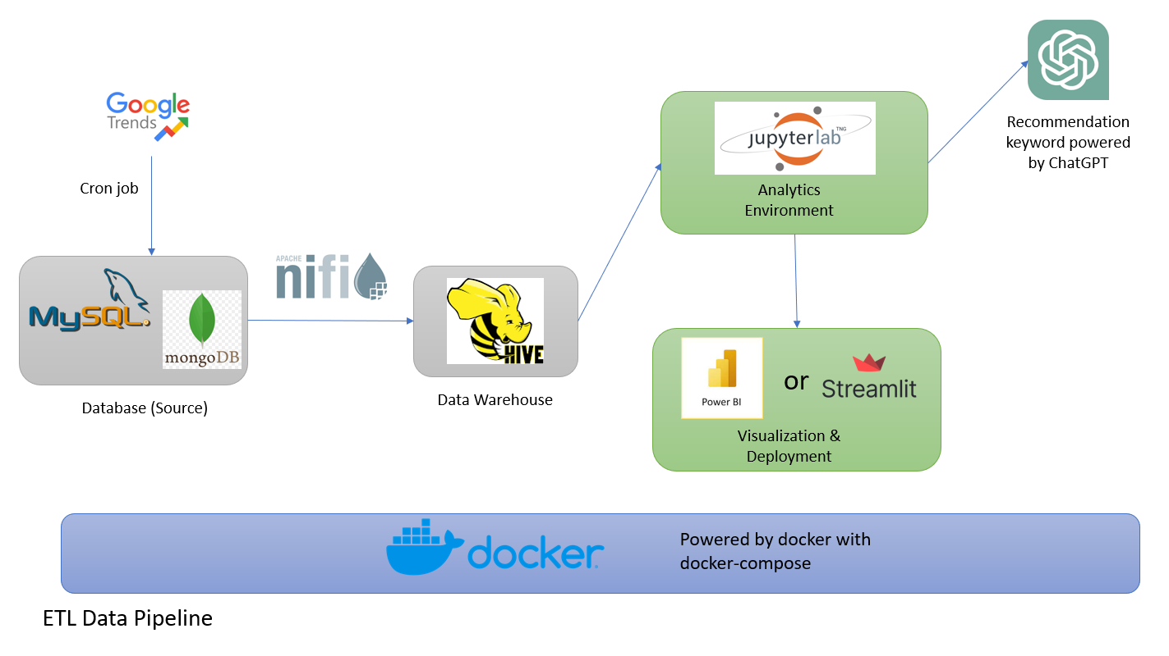
Intro
Architecture
Technology & Tools used
Project Infrastructure
P.R Algorithm
Results
Conclusion
MySQL: store the product data
MongoDB: store trending items retrieved from Google Trends
Apache Nifi: Combine data from MySQL and MongoDB in Hive
Hive: Data Warehouse – to determine the product for recommendation based on the current trend
ChatGPT: To identify the product to recommend & convert Google Trend item into related products
MongoDB: save generated list for visualization & deployment
Streamlit: Display recommended products

Slide 6
Intro
Architecture
Technology & Tools used
Project Infrastructure
P.R Algorithm
Results
Conclusion
HADOOP TOOLS
MySQL
MongoDB
Apache Nifi
Hive (Data Warehouse)
Hadoop
TOOLS SUPPORTING HADOOP
PhpMyAdmin
MySQL Workbench
Hue
DbVisualizer
ANALYTICS & VISUALIZATION TOOLS
JupyterLab
ChatGPT API
Streamlit
INFRASTRUCTURE TOOLS
Home Server
Docker & docker compose

Slide 7
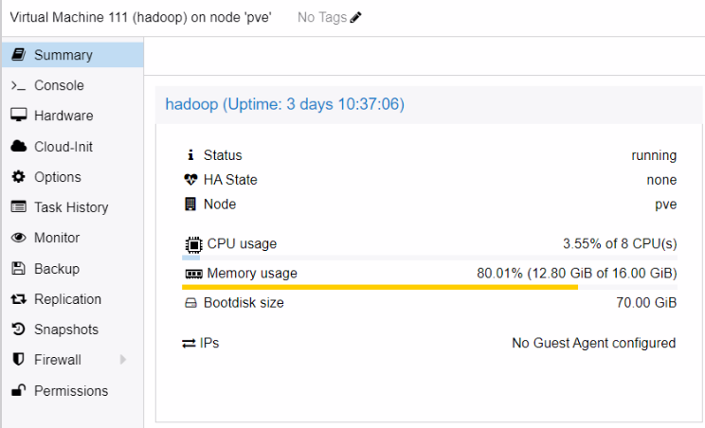
Intro
Architecture
Technology & Tools used
Project Infrastructure
P.R Algorithm
Results
Conclusion
Proxmox and virtual machines

Slide 8
Intro
Architecture
Technology & Tools used
Project Infrastructure
P.R Algorithm
Results
Conclusion
Tools used | URL to access the tools
MySQL | tersakiti.top:3306
MongoDB | tersakiti.top:27017
Apache Nifi | http://nifi.tersakiti.top:8080/nifi
JupyterLab | http://jupyterlab.tersakiti.top:8080
Mongo Express | http://mexpress.tersakiti.top:8080
Hue | http://hue.tersakiti.top:8080
PhpMyAdmin | http://phpmyadmin.tersakiti.top:8080
HDFS Namenode | http://namenode.tersakiti.top:8080
URL to access the tools used in the project.

Slide 9
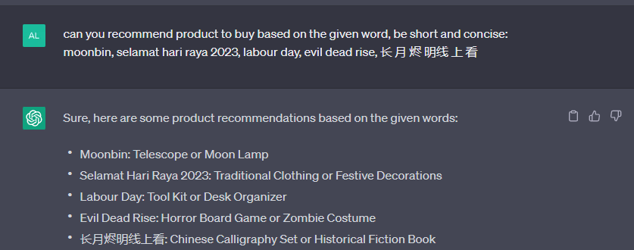
ChatGPT API
Intro
Architecture
Technology & Tools used
Project Infrastructure
P.R Algorithm
Results
Conclusion
Turn the trending item obtained from Google Trend into products to buy
Gives an idea of which product to buy based on the current trend
ChatGPT is not accessed through Graphical User Interface (GUI), but Application Programming Interface (API)
Account can be created by registering at OpenAI website

Slide 10
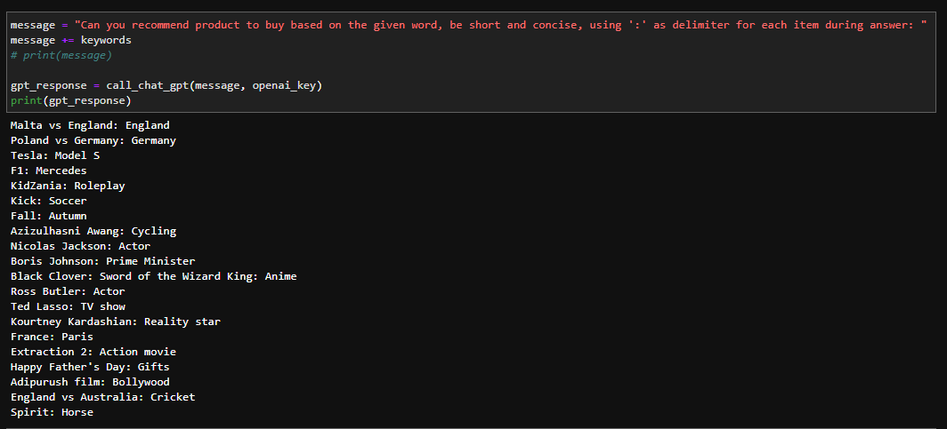
Intro
Architecture
Technology & Tools used
Project Infrastructure
P.R Algorithm
Results
Conclusion
Call to ChatGPT API and sample response

Slide 11
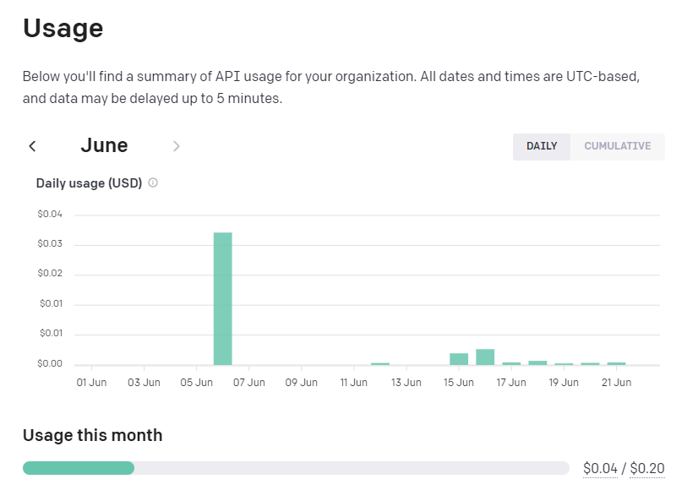
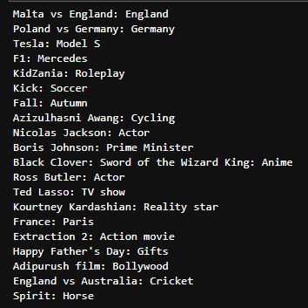
Intro
Architecture
Technology & Tools used
Project Infrastructure
P.R Algorithm
Results
Conclusion
usage of ChatGPT API is costing 0.04 USD
Model Used: gpt-3.5-turbo

Slide 12
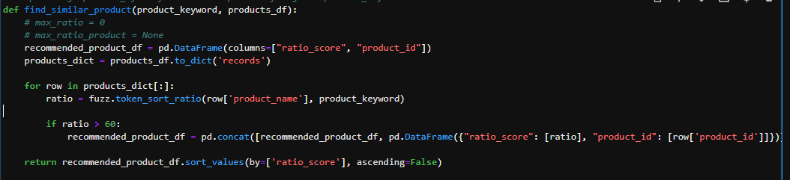
FUZZY SEARCH ALGORITHM
Intro
Architecture
Technology & Tools used
Project Infrastructure
P.R Algorithm
Results
Conclusion
Algorithm that is used to find patterns in strings (approximate string matching)
Levenshtein distance: minimum number of single-character edits (insertions, deletions, or substitutions)
Python package: fuzzy wuzzy - to find the similar product in the product database according to the product recommend by ChatGPT based on the trending item
Threshold for the Levenshtein distance is set at 60

Slide 13
DATASETS
Intro
Architecture
Technology & Tools used
Project Infrastructure
P.R Algorithm
Discussion & Results
Conclusion
Taken from Kaggle of Amazon product sales dataset 2023
142 categories; more than 300,000 products; 11 attributes
product_id attribute is added after combining all the csv file
dataset is then split into two datasets
Our group is using the second part of the dataset - product id starts from 198,123 instead of 1
the recommended product at the final product of data application is also different

Slide 14
Intro
Architecture
Technology & Tools used
Project Infrastructure
P.R Algorithm
Discussion & Results
Conclusion
Attribute name | Description
product_id | The unique identifier of the product
product_name | The name of the product
product_main_category | The main category of the product belong
product_sub_category | The sub category of the product belong
product_image_link | The image of the product look like
product_link | The amazon website reference link of the product
product_ratings | The ratings given by amazon customers of the product
product_num_of_ratings | The number of ratings given to this product in amazon shopping
product_discount_price | The discount prices of the product
product_actual_price | The actual MRP of the product
Attributes in the
dataset

Slide 15
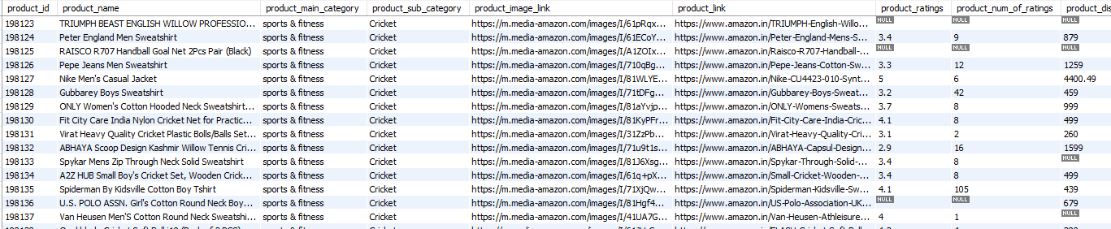
Intro
Architecture
Technology & Tools used
Project Infrastructure
P.R Algorithm
Discussion & Results
Conclusion
Second part of Amazon product dataset

Slide 16
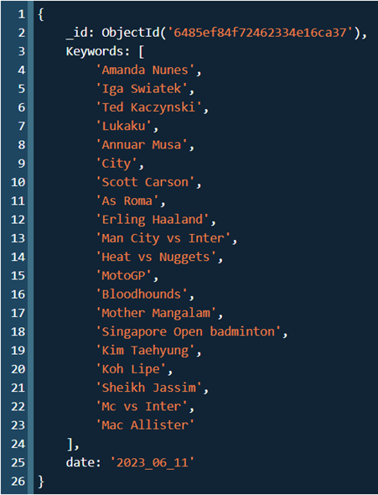
TRENDING RESULTS
Intro
Architecture
Technology & Tools used
Project Infrastructure
P.R Algorithm
Discussion & Results
Conclusion
Search trends are retrieved from Google Trends using pytrends library
Trending keywords are scraped from Google Trends daily
Date is included to differentiate the data from one another
Results are kept in MongoDB under the “GoogleTrend” database and “Trending” collection

Slide 17
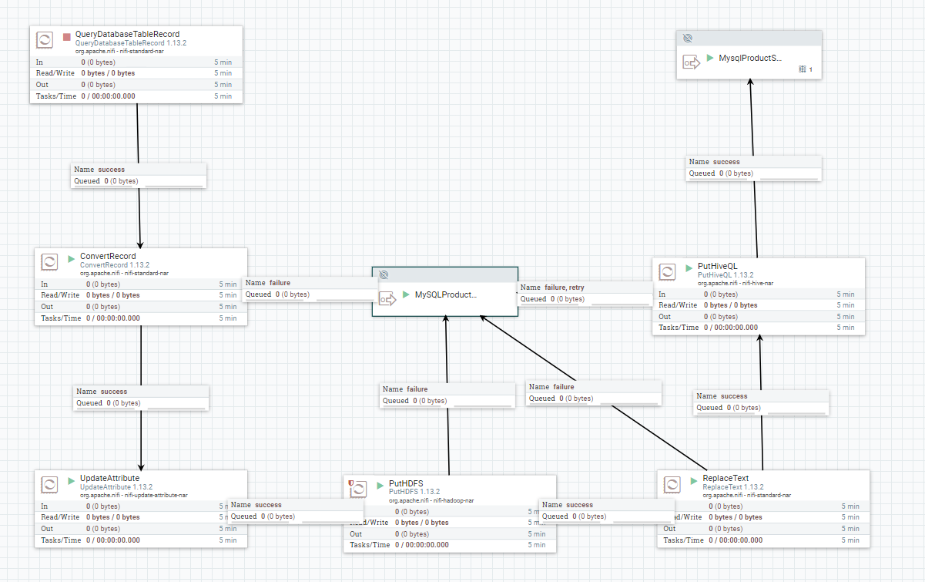
Intro
Architecture
Technology & Tools used
Project Infrastructure
P.R Algorithm
Discussion & Results
Conclusion
DATA PIPELINE
MySQL to Hive: the product data is first query from MySQL database then it is converted to csv and saved in HDFS.
product data csv is loaded into Hive using LOAD DATA INTO TABLE query
more efficient to use LOAD DATA INTO TABLE to insert the product data into Hive

Slide 18
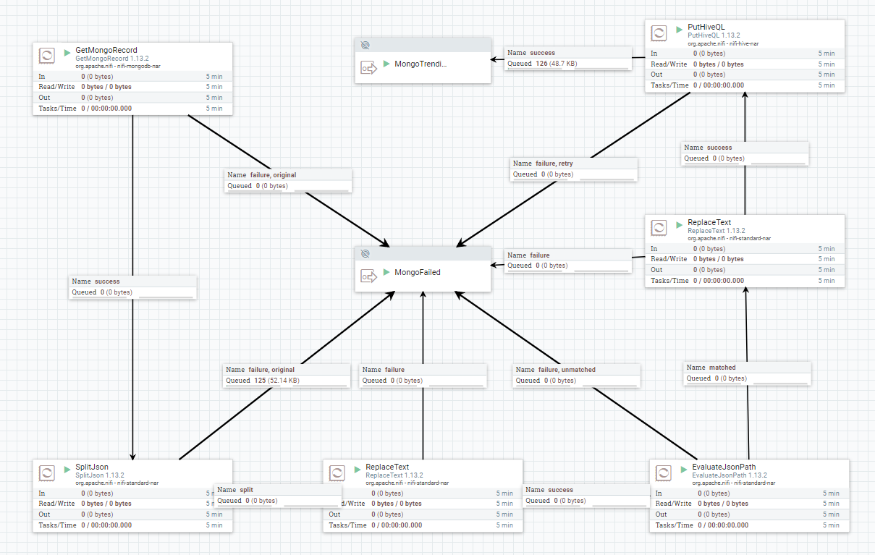
Intro
Architecture
Technology & Tools used
Project Infrastructure
P.R Algorithm
Discussion & Results
Conclusion
DATA PIPELINE
MongoDB to Hive: take the latest trending item from Google Trend from MongoDB and put it into Hive
Converting the latest trending item in JSON format into HiveQL statement using INSERT INTO

Slide 19
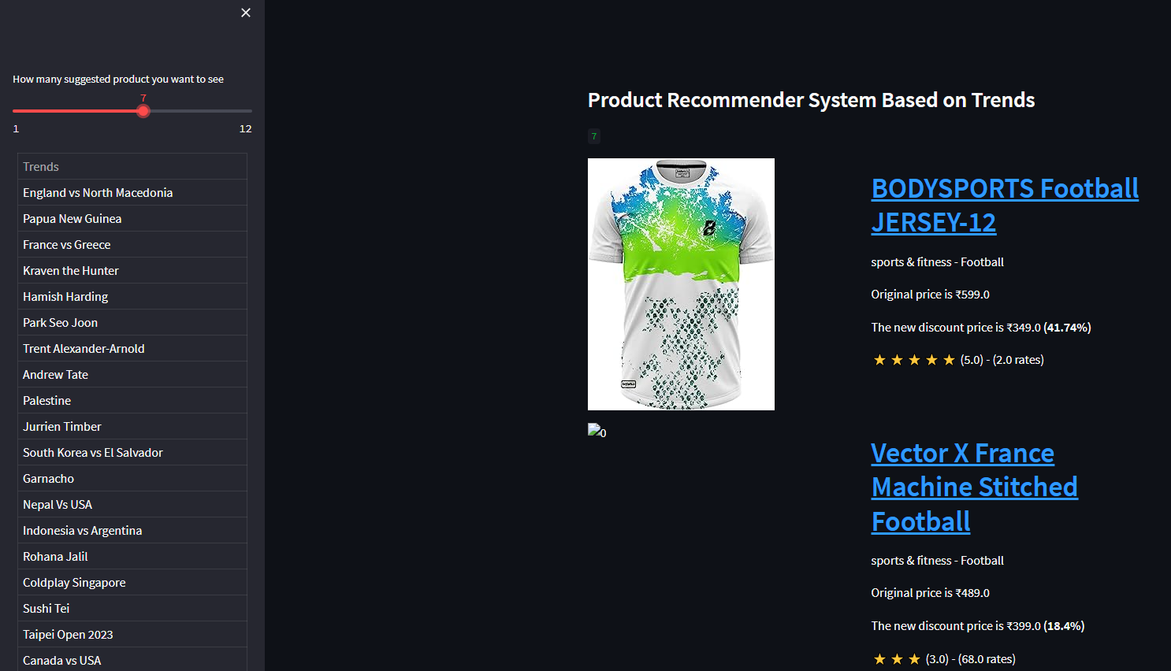
RESULTS (DATA APPLICATION)
Intro
Architecture
Technology & Tools used
Project Infrastructure
P.R Algorithm
Discussion & Results
Conclusion
Product recommendation system was developed with Streamlit
Current trends in the left sidebar.
Select how many suggested products based on the trends
Product appears based on the trends on the right
Web application provides a category for each product, the original price and discount price, and a product review
https://group3.streamlit.app

Slide 20
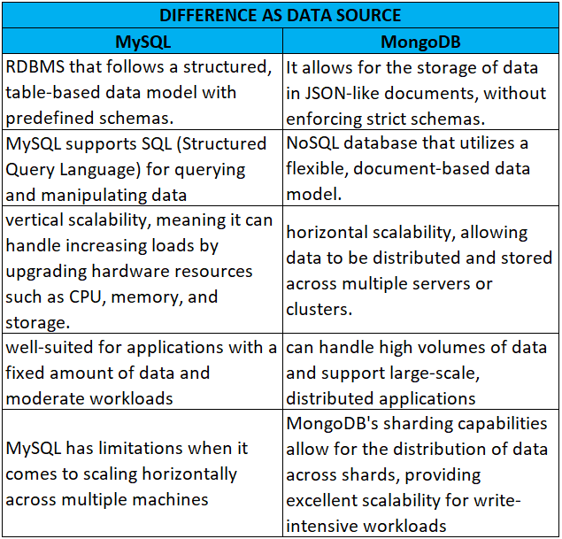
Intro
Architecture
Technology & Tools used
Project Infrastructure
P.R Algorithm
Discussion & Results
Conclusion
Comparison of MySQL and MongoDB as Data Source
MySQL may be the better choice if a well-defined schema and require complex transactions is needed
MongoDB will be more suitable if unstructured or rapidly evolving data is needed, and requires horizontal scalability and flexibility
In this project:
MySQL is stored a well-defined product data
MongoDB is used to store current trending item which is rapidly evolving data.

Slide 21
CONCLUSION
Intro
Architecture
Technology & Tools used
Project Infrastructure
P.R Algorithm
Discussion & Results
Conclusion
Project has developed a product recommendation system with a full data pipeline from data sources to data warehouse
Split into five parts, consisting of data source, data integration, data warehouse, analytics environment, and visualization & deployment.
MySQL and MongoDB are used to store product data and trending items to simulate the data source in the data pipeline.
Apache Nifi is used to integrate data from multiple sources into data warehouses.
Hive is used as data warehouses in this project, running on top of Apache Hadoop.
JupyterLab is used as the coding or analytics environment with python to write the pipeline to generate product recommendation based on current trending item.
Streamlit is used to visualize the recommended product and present it as a web application.

Slide 22
FUTURE WORK
Intro
Architecture
Technology & Tools used
Project Infrastructure
P.R Algorithm
Discussion & Results
Conclusion
Result can be included on the homepage of ecommerce websites instead of Streamlit as Streamlit is only for demonstration purposes only
Instead of using Amazon product, it can use real ecommerce website product as some of the product in the Amazon dataset is unavailable anymore.
It can prevent that the product image is being empty during the demonstration.

Slide 23
REFERENCES
Intro
Architecture
Technology & Tools used
Project Infrastructure
P.R Algorithm
Discussion & Results
Conclusion
Guru. (2023, April 12). Product recommendations helps retailers in 2023. Vue.ai Blog. https://vue.ai/blog/vuecommerce/product-recommendations-the-ultimate-guide/
Knotzer, Nicolas, "Product Recommendations in E-Commerce Retailing Applications".
https://library.oapen.org/bitstream/handle/20.500.12657/26821/1/1003224.pdf
Lee (2014), "The Impact of Recommender Systems on Consumers: Study of Sales Volume and Diversity". https://riskcenter.wharton.upenn.edu/wp-content/uploads/2014/07/Lee.pdf
Lee, D. & Hosanagar, K., 2017, "How Do Recommender Systems Affect Sales Diversity? A Cross-Category Investigation via Randomized Field Experiment". https://repository.upenn.edu/cgi/viewcontent.cgi?article=1341&context=marketing_papers
Rai, B. K. (2023). IOT based humidity and temperature control system for Smart Warehouse. Gazi University Journal of Science, 36(1), 173–188. https://doi.org/10.35378/gujs.993959

Slide 24
REFERENCES
Intro
Architecture
Technology & Tools used
Project Infrastructure
P.R Algorithm
Discussion & Results
Conclusion
Sarangpure, N., Dhamde, V., Roge, A., Doye, J., Patle, S., & Tamboli, S. (2023). Automating the machine learning process using pycaret and Streamlit. 2023 2nd International Conference for Innovation in Technology (INOCON). https://doi.org/10.1109/inocon57975.2023.10101357
OpenAI API. OpenAI Platform. (n.d.). https://platform.openai.com/docs/introduction/overview
Paiva, S. (2013). A fuzzy algorithm for optimizing semantic documental searches. Procedia Technology, 9, 1–10. https://doi.org/10.1016/j.protcy.2013.12.001
V. I. Levenshtein. (1965). Binary codes with correction of dropouts, insertions and substitutions of symbols. Dokl. Academy of Sciences of the USSR, 163(4), 845–848.

Slide 25
REFERENCES
Intro
Architecture
Technology & Tools used
Project Infrastructure
P.R Algorithm
Discussion & Results
Conclusion
Parab, L. (2023, March 26). Amazon Products Sales Dataset 2023. Kaggle. https://www.kaggle.com/datasets/lokeshparab/amazon-products-dataset?select=All%2BElectronics.csv
OpenAI. (2023). Chatgpt. ChatGPT. https://openai.com/chatgpt

Slide 26
#ThankYou

